Slide 1
Inheritance
Mohammad Salman
Dean’s Fellow

Slide 2
Let’s Implement Inheritance!
Public Inheritance is what we’ll primarily look at in this course.
https://www.learncpp.com/cpp-tutorial/basic-inheritance-in-c/

Slide 3
Recap of some basic ideas from last time…
A derived class extends the capabilities of its base class.
A derived class is typically more specialized than its base class.
You can have multiple levels of inheritance (chaining inheritance).
Inheritance vs. composition – a design decision.

Slide 4
Public Inheritance
There are other types of inheritance as well.
Public inheritance is generally the more common one and easy to understand as well.
The access levels of the inherited members within the derived class is the same as the access levels of those members in the base class.

Slide 5
Let’s say we have a class Person.
Objects of this class would be a generic person. The members of this class reflect that.
class Person
{
private:
std::string m_name;
int m_age;
public:
Person()
: m_name{ "Unnamed" }, m_age{ -1 }
{}
Person(const char name[], int age = -1)
: m_name{ name }, m_age{ age }
{}
const std::string& getName() const
{ return m_name; }
int getAge() const
{ return m_age; }
};
int main()
{
Person daffy{ "Daffy Duck", 86 };
std::cout << daffy.getName() << ", "
<< daffy.getAge();
return 0;
}
Note
You can write this code in your editor, and hover over the string literal to see its data type.

Slide 6
If I want to represent a cricketer, I can extend the Person class using (public) inheritance to include cricketer specific information.
So now an object of CricketPlayer will inherit all members from the Person class, and have its own members as well – Person has been specialized into a CricketPlayer.
class Person
{
private:
std::string m_name;
int m_age;
public:
Person()
: m_name{ "Unnamed" }, m_age{ -1 }
{}
Person(const char name[], int age = -1)
: m_name{ name }, m_age{ age }
{}
const std::string& getName() const
{ return m_name; }
int getAge() const
{ return m_age; }
};
class CricketPlayer : public Person
{
private:
double m_strikeRate;
int m_totalRuns;
public:
CricketPlayer(double sr = 0.0, int runs = 0)
: m_strikeRate{sr}, m_totalRuns{runs}
{}
};
One way to achieve this result could be to just copy-paste the Person’s members in CrickerPlayer – bad idea.
Between composition and inheritance, inheritance makes conceptual sense here.
A CricketPlayer is-a Person.

Slide 7
You’ll see that this program runs fine.
The inherited member, getName(), is being used.
Unnamed is received as an output.
Key
- private members
+ public members
Person
- m_name - m_age
+ getName() + getAge()
int main()
{
// Create a new CricketPlayer object
CricketPlayer abcd;
std::cout << abcd.getName();
return 0;
}
CricketPlayer
- m_strikeRate - m_totalRuns
Try to understand this output. Hopefully, by the end of the week, you should be in a good spot to figure this out.

Slide 8
Order of Construction and Destruction of Derived Classes
Closer look at the order of construction and destruction for a derived class.
Please do read the article at the following link.
https://www.learncpp.com/cpp-tutorial/order-of-construction-of-derived-classes/

Slide 9
class Base
{
private:
int m_id;
public:
Base()
: m_id { 0 }
{ std::cout << "Default Base\n"; }
Base(int id)
: m_id { id }
{ std::cout << "One-arg Base\n"; }
~Base() { std::cout << "Base destructor\n"; }
int getId() const { return m_id; }
};
class Derived : public Base
{
private:
double m_cost;
public:
Derived()
: m_cost { 0.0 }
{ std::cout << "Default Derived\n"; }
Derived(double cost)
: m_cost { cost }
{ std::cout << "One-arg Derived\n"; }
~Derived() { std::cout << "Derived destructor\n"; }
double getCost() const { return m_cost; }
};
Base
- m_id
+ getId()
This is not a fully specified UML Class Diagram, but it still reveals a lot of information about,
the class definitions of Base and Derived, and
the relationship between them (which is inheritance in this example).
Derived
- m_cost
+ getCost()
Notes:
Get used to reading UML.

Slide 10
class Base
{
private:
int m_id;
public:
Base()
: m_id { 0 }
{ std::cout << "Default Base\n"; }
Base(int id)
: m_id { id }
{ std::cout << "One-arg Base\n"; }
~Base() { std::cout << "Base destructor\n"; }
int getId() const { return m_id; }
};
class Derived : public Base
{
private:
double m_cost;
public:
Derived()
: m_cost { 0.0 }
{ std::cout << "Default Derived\n"; }
Derived(double cost)
: m_cost { cost }
{ std::cout << "One-arg Derived\n"; }
~Derived() { std::cout << "Derived destructor\n"; }
double getCost() const { return m_cost; }
};
Base int m_id int getId() const
Derived double m_cost double getCost() const
We consider an object of the Derived class as a multi-part object. One part is its own, and the rest belong to each of its parent(s) in its inheritance chain.
In this example, these are its parts:
one part Base.
one part Derived.
Derived d;

Slide 11
class Base
{
private:
int m_id;
public:
Base()
: m_id { 0 }
{ std::cout << "Default Base\n"; }
Base(int id)
: m_id { id }
{ std::cout << "One-arg Base\n"; }
~Base() { std::cout << "Base destructor\n"; }
int getId() const { return m_id; }
};
class Derived : public Base
{
private:
double m_cost;
public:
Derived()
: m_cost { 0.0 }
{ std::cout << "Default Derived\n"; }
Derived(double cost)
: m_cost { cost }
{ std::cout << "One-arg Derived\n"; }
~Derived() { std::cout << "Derived destructor\n"; }
double getCost() const { return m_cost; }
};
Let’s revisit how objects are created.
We will create an object of class Base first.

Slide 12
class Base
{
private:
int m_id;
public:
Base()
: m_id { 0 }
{ std::cout << "Default Base\n"; }
Base(int id)
: m_id { id }
{ std::cout << "One-arg Base\n"; }
~Base() { std::cout << "Base destructor\n"; }
int getId() const { return m_id; }
};
class Derived : public Base
{
private:
double m_cost;
public:
Derived()
: m_cost { 0.0 }
{ std::cout << "Default Derived\n"; }
Derived(double cost)
: m_cost { cost }
{ std::cout << "One-arg Derived\n"; }
~Derived() { std::cout << "Derived destructor\n"; }
double getCost() const { return m_cost; }
};
Output
int main()
{
Base b1;
return 0;
}
Firstly, main() is called.

Slide 13
class Base
{
private:
int m_id;
public:
Base()
: m_id { 0 }
{ std::cout << "Default Base\n"; }
Base(int id)
: m_id { id }
{ std::cout << "One-arg Base\n"; }
~Base() { std::cout << "Base destructor\n"; }
int getId() const { return m_id; }
};
class Derived : public Base
{
private:
double m_cost;
public:
Derived()
: m_cost { 0.0 }
{ std::cout << "Default Derived\n"; }
Derived(double cost)
: m_cost { cost }
{ std::cout << "One-arg Derived\n"; }
~Derived() { std::cout << "Derived destructor\n"; }
double getCost() const { return m_cost; }
};
Base int m_id = ??? int getId() const
Output
int main()
{
Base b1;
return 0;
}
Memory for the object is allocated by the compiler.

Slide 14
class Base
{
private:
int m_id;
public:
Base()
: m_id { 0 }
{ std::cout << "Default Base\n"; }
Base(int id)
: m_id { id }
{ std::cout << "One-arg Base\n"; }
~Base() { std::cout << "Base destructor\n"; }
int getId() const { return m_id; }
};
class Derived : public Base
{
private:
double m_cost;
public:
Derived()
: m_cost { 0.0 }
{ std::cout << "Default Derived\n"; }
Derived(double cost)
: m_cost { cost }
{ std::cout << "One-arg Derived\n"; }
~Derived() { std::cout << "Derived destructor\n"; }
double getCost() const { return m_cost; }
};
Base int m_id = 0 int getId() const
Output
int main()
{
Base b1;
return 0;
}
Ctor gets called and initialization happens.

Slide 15
class Base
{
private:
int m_id;
public:
Base()
: m_id { 0 }
{ std::cout << "Default Base\n"; }
Base(int id)
: m_id { id }
{ std::cout << "One-arg Base\n"; }
~Base() { std::cout << "Base destructor\n"; }
int getId() const { return m_id; }
};
class Derived : public Base
{
private:
double m_cost;
public:
Derived()
: m_cost { 0.0 }
{ std::cout << "Default Derived\n"; }
Derived(double cost)
: m_cost { cost }
{ std::cout << "One-arg Derived\n"; }
~Derived() { std::cout << "Derived destructor\n"; }
double getCost() const { return m_cost; }
};
Base int m_id = 0 int getId() const
Output
Default Base
int main()
{
Base b1;
return 0;
}
Body of the ctor executes.

Slide 16
class Base
{
private:
int m_id;
public:
Base()
: m_id { 0 }
{ std::cout << "Default Base\n"; }
Base(int id)
: m_id { id }
{ std::cout << "One-arg Base\n"; }
~Base() { std::cout << "Base destructor\n"; }
int getId() const { return m_id; }
};
class Derived : public Base
{
private:
double m_cost;
public:
Derived()
: m_cost { 0.0 }
{ std::cout << "Default Derived\n"; }
Derived(double cost)
: m_cost { cost }
{ std::cout << "One-arg Derived\n"; }
~Derived() { std::cout << "Derived destructor\n"; }
double getCost() const { return m_cost; }
};
Base int m_id = 0 int getId() const
Output
Default Base
int main()
{
Base b1;
return 0;
}
The control is returned back to main().

Slide 17
class Base
{
private:
int m_id;
public:
Base()
: m_id { 0 }
{ std::cout << "Default Base\n"; }
Base(int id)
: m_id { id }
{ std::cout << "One-arg Base\n"; }
~Base() { std::cout << "Base destructor\n"; }
int getId() const { return m_id; }
};
class Derived : public Base
{
private:
double m_cost;
public:
Derived()
: m_cost { 0.0 }
{ std::cout << "Default Derived\n"; }
Derived(double cost)
: m_cost { cost }
{ std::cout << "One-arg Derived\n"; }
~Derived() { std::cout << "Derived destructor\n"; }
double getCost() const { return m_cost; }
};
Base int m_id = 0 int getId() const
Output
Default Base
Base destructor
int main()
{
Base b1;
return 0;
}
Compiler automatically will attempt to deallocate memory occupied by b1. So its destructor is called.

Slide 18
The Construction Process
Memory for b1 is set aside.
The appropriate Base constructor is called.
The member initializer list initializes variables.
The body of the constructor executes.
Control is returned to the caller.
int main()
{
// use Base() constructor
Base b1;
return 0;
}
Base::Base()
: m_id { 0 }
{
std::cout << "Base\n";
}

Slide 19
class Base
{
private:
int m_id;
public:
Base()
: m_id { 0 }
{ std::cout << "Default Base\n"; }
Base(int id)
: m_id { id }
{ std::cout << "One-arg Base\n"; }
~Base() { std::cout << "Base destructor\n"; }
int getId() const { return m_id; }
};
class Derived : public Base
{
private:
double m_cost;
public:
Derived()
: m_cost { 0.0 }
{ std::cout << "Default Derived\n"; }
Derived(double cost)
: m_cost { cost }
{ std::cout << "One-arg Derived\n"; }
~Derived() { std::cout << "Derived destructor\n"; }
double getCost() const { return m_cost; }
};
Output
int main()
{
Derived d1;
return 0;
}
Now we will see the construction of a Derived object.

Slide 20
class Base
{
private:
int m_id;
public:
Base()
: m_id { 0 }
{ std::cout << "Default Base\n"; }
Base(int id)
: m_id { id }
{ std::cout << "One-arg Base\n"; }
~Base() { std::cout << "Base destructor\n"; }
int getId() const { return m_id; }
};
class Derived : public Base
{
private:
double m_cost;
public:
Derived()
: m_cost { 0.0 }
{ std::cout << "Default Derived\n"; }
Derived(double cost)
: m_cost { cost }
{ std::cout << "One-arg Derived\n"; }
~Derived() { std::cout << "Derived destructor\n"; }
double getCost() const { return m_cost; }
};
Base int m_id = ??? int getId() const
Derived double m_cost = ??? double getCost() const
Output
int main()
{
Derived d1;
return 0;
}
Notes:
Memory is allocated by the compiler.

Slide 21
class Base
{
private:
int m_id;
public:
Base()
: m_id { 0 }
{ std::cout << "Default Base\n"; }
Base(int id)
: m_id { id }
{ std::cout << "One-arg Base\n"; }
~Base() { std::cout << "Base destructor\n"; }
int getId() const { return m_id; }
};
class Derived : public Base
{
private:
double m_cost;
public:
Derived()
: m_cost { 0.0 }
{ std::cout << "Default Derived\n"; }
Derived(double cost)
: m_cost { cost }
{ std::cout << "One-arg Derived\n"; }
~Derived() { std::cout << "Derived destructor\n"; }
double getCost() const { return m_cost; }
};
Base int m_id = ??? int getId() const
Derived double m_cost = ??? double getCost() const
Output
int main()
{
Derived d1;
return 0;
}
Notes:
Derived() is called. But it is derived from a base class.
So before I even initialize, I will go to the parent’s ctor.

Slide 22
class Base
{
private:
int m_id;
public:
Base()
: m_id { 0 }
{ std::cout << "Default Base\n"; }
Base(int id)
: m_id { id }
{ std::cout << "One-arg Base\n"; }
~Base() { std::cout << "Base destructor\n"; }
int getId() const { return m_id; }
};
class Derived : public Base
{
private:
double m_cost;
public:
Derived()
: m_cost { 0.0 }
{ std::cout << "Default Derived\n"; }
Derived(double cost)
: m_cost { cost }
{ std::cout << "One-arg Derived\n"; }
~Derived() { std::cout << "Derived destructor\n"; }
double getCost() const { return m_cost; }
};
Even the initialization doesn’t happen.
Base int m_id = ??? int getId() const
Derived double m_cost = ??? double getCost() const
You may ask why the default version of Base() gets called.
This is because we haven’t told the compiler which version to call.
This will become clearer when we start the next phase of our discussion.
Output
int main()
{
Derived d1;
return 0;
}
Notes:
So the compiler calls Base().
This is the most base class. So we stop here.

Slide 23
class Base
{
private:
int m_id;
public:
Base()
: m_id { 0 }
{ std::cout << "Default Base\n"; }
Base(int id)
: m_id { id }
{ std::cout << "One-arg Base\n"; }
~Base() { std::cout << "Base destructor\n"; }
int getId() const { return m_id; }
};
class Derived : public Base
{
private:
double m_cost;
public:
Derived()
: m_cost { 0.0 }
{ std::cout << "Default Derived\n"; }
Derived(double cost)
: m_cost { cost }
{ std::cout << "One-arg Derived\n"; }
~Derived() { std::cout << "Derived destructor\n"; }
double getCost() const { return m_cost; }
};
Base int m_id = 0 int getId() const
Derived double m_cost = ??? double getCost() const
Output
Default Base
int main()
{
Derived d1;
return 0;
}
Notes:
Initialization happens and the body of Base() executes. After this, the control is returned back to Derived().

Slide 24
class Base
{
private:
int m_id;
public:
Base()
: m_id { 0 }
{ std::cout << "Default Base\n"; }
Base(int id)
: m_id { id }
{ std::cout << "One-arg Base\n"; }
~Base() { std::cout << "Base destructor\n"; }
int getId() const { return m_id; }
};
class Derived : public Base
{
private:
double m_cost;
public:
Derived()
: m_cost { 0.0 }
{ std::cout << "Default Derived\n"; }
Derived(double cost)
: m_cost { cost }
{ std::cout << "One-arg Derived\n"; }
~Derived() { std::cout << "Derived destructor\n"; }
double getCost() const { return m_cost; }
};
Base int m_id = 0 int getId() const
Derived double m_cost = 0.0 double getCost() const
Output
Default Base
Default Derived
int main()
{
Derived d1;
return 0;
}
Notes:
Initialization happens and the body of Derived() executes. After this, the control is returned back to main().

Slide 25
class Base
{
private:
int m_id;
public:
Base()
: m_id { 0 }
{ std::cout << "Default Base\n"; }
Base(int id)
: m_id { id }
{ std::cout << "One-arg Base\n"; }
~Base() { std::cout << "Base destructor\n"; }
int getId() const { return m_id; }
};
class Derived : public Base
{
private:
double m_cost;
public:
Derived()
: m_cost { 0.0 }
{ std::cout << "Default Derived\n"; }
Derived(double cost)
: m_cost { cost }
{ std::cout << "One-arg Derived\n"; }
~Derived() { std::cout << "Derived destructor\n"; }
double getCost() const { return m_cost; }
};
Base int m_id = 0 int getId() const
Derived double m_cost = 0.0 double getCost() const
Output
Default Base
Default Derived
int main()
{
Derived d1;
return 0;
}
Notes:
I then return to main(), and so my d1 object is ready.

Slide 26
class Base
{
private:
int m_id;
public:
Base()
: m_id { 0 }
{ std::cout << "Default Base\n"; }
Base(int id)
: m_id { id }
{ std::cout << "One-arg Base\n"; }
~Base() { std::cout << "Base destructor\n"; }
int getId() const { return m_id; }
};
class Derived : public Base
{
private:
double m_cost;
public:
Derived()
: m_cost { 0.0 }
{ std::cout << "Default Derived\n"; }
Derived(double cost)
: m_cost { cost }
{ std::cout << "One-arg Derived\n"; }
~Derived() { std::cout << "Derived destructor\n"; }
double getCost() const { return m_cost; }
};
Base int m_id = 0 int getId() const
Derived double m_cost = 0.0 double getCost() const
Output
Default Base
Default Derived
Derived destructor
Base destructor
int main()
{
Derived d1;
return 0;
}
Destruction happens in the reverse order.
Notes:
Now is time for automatic deallocation (b/c it’s on stack memory).
Destruction happens in the reverse order of construction. First ~Derived() gets called (and executes) and then ~Base() gets called (and executes).

Slide 27
The Construction Process
Memory for d1 is set aside (enough for both the Base and Derived portions).
The appropriate Derived constructor is called.
The Base object is constructed first using the appropriate Base constructor.
In this case, it is the default constructor because we haven’t specified anything.
The member initializer list initializes variables.
The body of the constructor executes.
Control is returned to the Derived constructor, which after finishing, returns the control back to the main().
int main()
{
// use Derived(double) constructor
Derived d1;
return 0;
}
Derived::Derived()
: m_cost { 0.0 }
{
std::cout << "Derived\n";
}
Base::Base()
: m_id { 0 }
{
std::cout << "Base\n";
}
Notes:
A reason why the order of construction and destruction is the way it is, is because if let’s say for construction, your Derived() gets called first, then it could be the case that since a derived object should have access to inherited members, it could be accessing some of those inherited members (public and protected) within the ctor (Derived()). But if the base part hasn’t been initialized, then how can you access inherited members in Derived().
Same for destruction. If you destroy the base part first, it could be the case that the ~Derived() might be working on the inherited members. But if the base part has already been destructed, then how can ~Derived() work on the inherited members.

Slide 28
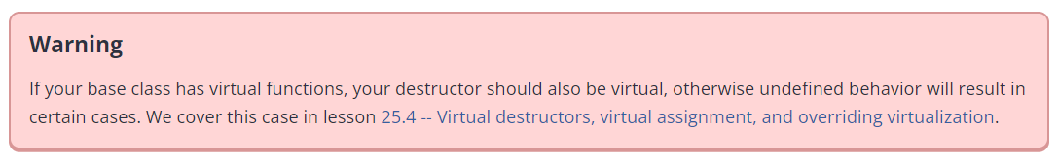
Destruction of derived objects
When an object of a derived class is destroyed, each destructor is called in the reverse order of construction.
Following will come later.

Slide 29
Initializing Derived Classes
Please do read the article at the following link.
https://www.learncpp.com/cpp-tutorial/constructors-and-initialization-of-derived-classes/

Slide 30
Initializing Inherited Members
We saw that when creating the Derived-type object, the compiler implicitly called the default Base constructor.
We can control which variant of the parent constructor gets called.
This helps with initializing the inherited members.

Slide 31
In order to create d1, I’m providing two initializing values.
So I would need a two-arg ctor in the Derived class.
int main()
{
Derived d1{ 17, 200.0 };
std::cout << "Printing d1: \n"
<< d1.getId() << ", "
<< d1.getCost() << '\n';
return 0;
}

Slide 32
class Derived: public Base
{
private:
double m_cost;
public:
Derived()
: m_cost { 0.0 }
{ std::cout << "Default Derived\n"; }
Derived(int id, double cost)
: m_cost{ cost }
{ std::cout << "Two-arg Derived\n"; }
~Derived() { std::cout << "Derived destructor\n"; }
double getCost() const { return m_cost; }
};
I have updated the one-arg ctor so that it can instead accept two arguments.
int main()
{
Derived d1{ 17, 200.0 };
std::cout << "Printing d1: \n"
<< d1.getId() << ", "
<< d1.getCost() << '\n';
return 0;
}

Slide 33
class Base
{
private:
int m_id;
public:
Base()
: m_id { 0 }
{ std::cout << "Default Base\n"; }
Base(int id)
: m_id { id }
{ std::cout << "One-arg Base\n"; }
~Base() { std::cout << "Base destructor\n"; }
int getId() const { return m_id; }
};
class Derived: public Base
{
private:
double m_cost;
public:
Derived()
: m_cost { 0.0 }
{ std::cout << "Default Derived\n"; }
Derived(int id, double cost)
: m_cost{ cost }
{ std::cout << "Two-arg Derived\n"; }
~Derived() { std::cout << "Derived destructor\n"; }
double getCost() const { return m_cost; }
};
The Base class stays untouched for this example.
int main()
{
Derived d1{ 17, 200.0 };
std::cout << "Printing d1: \n"
<< d1.getId() << ", "
<< d1.getCost() << '\n';
return 0;
}

Slide 34
class Base
{
private:
int m_id;
public:
Base()
: m_id { 0 }
{ std::cout << "Default Base\n"; }
Base(int id)
: m_id { id }
{ std::cout << "One-arg Base\n"; }
~Base() { std::cout << "Base destructor\n"; }
int getId() const { return m_id; }
};
class Derived: public Base
{
private:
double m_cost;
public:
Derived()
: m_cost { 0.0 }
{ std::cout << "Default Derived\n"; }
Derived(int id, double cost)
: m_cost{ cost }
{ std::cout << "Two-arg Derived\n"; }
~Derived() { std::cout << "Derived destructor\n"; }
double getCost() const { return m_cost; }
};
When the compiler sees our intent to instantiate d1, it will call the appropriate ctor (after allocating sufficient memory for it).
Within the ctor, id = 17, cost = 200.0
Note that these variables are local to the ctor.
int main()
{
Derived d1{ 17, 200.0 };
std::cout << "Printing d1: \n"
<< d1.getId() << ", "
<< d1.getCost() << '\n';
return 0;
}

Slide 35
class Base
{
private:
int m_id;
public:
Base()
: m_id { 0 }
{ std::cout << "Default Base\n"; }
Base(int id)
: m_id { id }
{ std::cout << "One-arg Base\n"; }
~Base() { std::cout << "Base destructor\n"; }
int getId() const { return m_id; }
};
class Derived: public Base
{
private:
double m_cost;
public:
Derived()
: m_cost { 0.0 }
{ std::cout << "Default Derived\n"; }
Derived(int id, double cost)
: m_cost{ cost }
{ std::cout << "Two-arg Derived\n"; }
~Derived() { std::cout << "Derived destructor\n"; }
double getCost() const { return m_cost; }
};
Before doing anything in Derived(), the compiler goes to its parent’s ctor.
In this case, it goes to default parent ctor because we didn’t give the compiler any relevant information on where to go.
So, in this case, d1.m_id is now initialized to 0 instead of 17.
Note that d1.m_cost still hasn’t been initialized.
int main()
{
Derived d1{ 17, 200.0 };
std::cout << "Printing d1: \n"
<< d1.getId() << ", "
<< d1.getCost() << '\n';
return 0;
}
Notes:
Before even the initialization of m_cost in Derived(), the compiler goes to the parent’s ctor.

Slide 36
class Derived: public Base
{
private:
double m_cost;
public:
Derived()
: m_cost { 0.0 }
{ std::cout << "Default Derived\n"; }
Derived(int id, double cost)
: Base{ id }, m_cost{ cost }
{ std::cout << "Two-arg Derived\n"; }
~Derived() { std::cout << "Derived destructor\n"; }
double getCost() const { return m_cost; }
};
This is how we tell the compiler which ctor to call.
We make the call to the relevant parent ctor within the member initializer list of the child ctor.

Slide 37
class Base
{
private:
int m_id;
public:
Base()
: m_id { 0 }
{ std::cout << "Default Base\n"; }
Base(int id)
: m_id { id }
{ std::cout << "One-arg Base\n"; }
~Base() { std::cout << "Base destructor\n"; }
int getId() const { return m_id; }
};
class Derived: public Base
{
private:
double m_cost;
public:
Derived()
: m_cost { 0.0 }
{ std::cout << "Default Derived\n"; }
Derived(int id, double cost)
: Base{ id }, m_cost{ cost }
{ std::cout << "Two-arg Derived\n"; }
~Derived() { std::cout << "Derived destructor\n"; }
double getCost() const { return m_cost; }
};
Making this one change shifts the flow of the program.
Based on your member init list, the compiler now goes to the one-arg ctor in the parent class.
int main()
{
Derived d1{ 17, 200.0 };
std::cout << "Printing d1: \n"
<< d1.getId() << ", "
<< d1.getCost() << '\n';
return 0;
}

Slide 38
class Base
{
private:
int m_id;
public:
Base()
: m_id { 0 }
{ std::cout << "Default Base\n"; }
Base(int id)
: m_id { id }
{ std::cout << "One-arg Base\n"; }
~Base() { std::cout << "Base destructor\n"; }
int getId() const { return m_id; }
};
class Derived: public Base
{
private:
double m_cost;
public:
Derived()
: m_cost { 0.0 }
{ std::cout << "Default Derived\n"; }
Derived(int id, double cost)
: Base{ id }, m_cost{ cost }
{ std::cout << "Two-arg Derived\n"; }
~Derived() { std::cout << "Derived destructor\n"; }
double getCost() const { return m_cost; }
};
And so the cool thing about this is that id = 17 is now passed to Base(int) ctor.
So it can use id to initialize the inherited member, m_id, of d1 to 17, which was supplied as an initializing value.
In other words, d1.m_id is now initialized to 17.
int main()
{
Derived d1{ 17, 200.0 };
std::cout << "Printing d1: \n"
<< d1.getId() << ", "
<< d1.getCost() << '\n';
return 0;
}

Slide 39
class Base
{
private:
int m_id;
public:
Base()
: m_id { 0 }
{ std::cout << "Default Base\n"; }
Base(int id)
: m_id { id }
{ std::cout << "One-arg Base\n"; }
~Base() { std::cout << "Base destructor\n"; }
int getId() const { return m_id; }
};
class Derived: public Base
{
private:
double m_cost;
public:
Derived()
: m_cost { 0.0 }
{ std::cout << "Default Derived\n"; }
Derived(int id, double cost)
: Base{ id }, m_cost{ cost }
{ std::cout << "Two-arg Derived\n"; }
~Derived() { std::cout << "Derived destructor\n"; }
double getCost() const { return m_cost; }
};
After the parent ctor finishes execution, control is returned back to the child ctor.
It then initializes the m_cost attribute to 200.0.
And then the control is returned back to main().
int main()
{
Derived d1{ 17, 200.0 };
std::cout << "Printing d1: \n"
<< d1.getId() << ", "
<< d1.getCost() << '\n';
return 0;
}

Slide 40
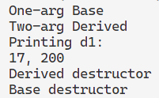
class Base
{
private:
int m_id;
public:
Base()
: m_id { 0 }
{ std::cout << "Default Base\n"; }
Base(int id)
: m_id { id }
{ std::cout << "One-arg Base\n"; }
~Base() { std::cout << "Base destructor\n"; }
int getId() const { return m_id; }
};
class Derived: public Base
{
private:
double m_cost;
public:
Derived()
: m_cost { 0.0 }
{ std::cout << "Default Derived\n"; }
Derived(int id, double cost)
: Base{ id }, m_cost{ cost }
{ std::cout << "Two-arg Derived\n"; }
~Derived() { std::cout << "Derived destructor\n"; }
double getCost() const { return m_cost; }
};
Order of construction
int main()
{
Derived d1{ 17, 200.0 };
std::cout << "Printing d1: \n"
<< d1.getId() << ", "
<< d1.getCost() << '\n';
return 0;
}
Initialization
Order of destruction

Slide 41
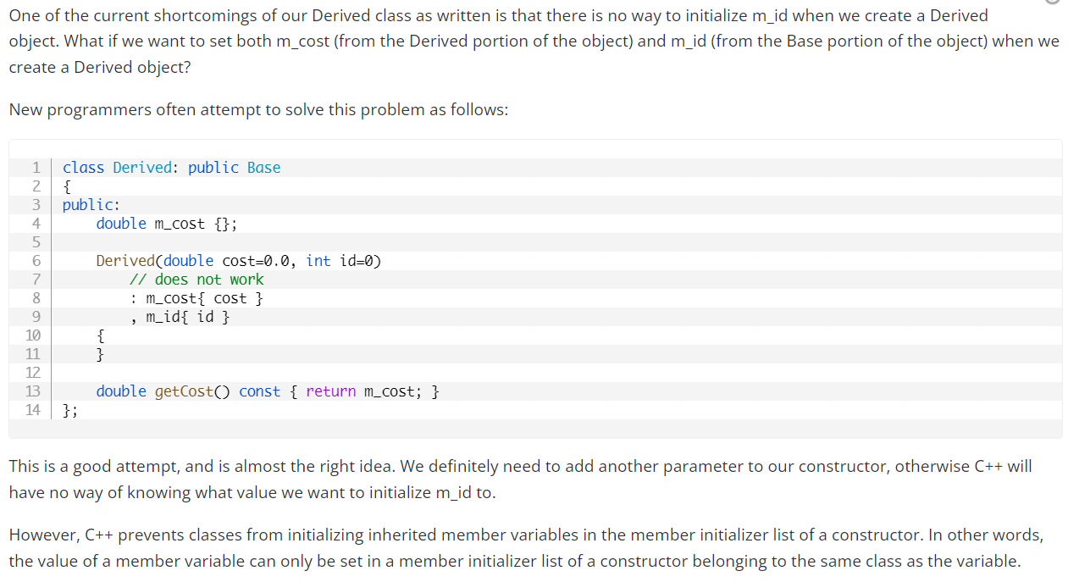
Why will the following modification to the child ctor not work?
Go read :P
https://www.learncpp.com/cpp-tutorial/constructors-and-initialization-of-derived-classes/

Slide 42
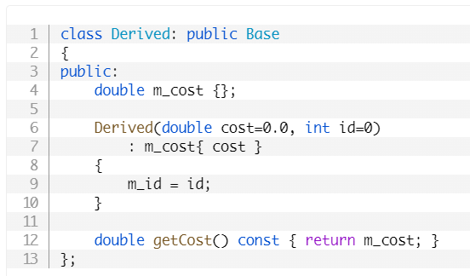
Why will the following modification to the child ctor not work?
Go read (same link as on the previous slide) :P
Also, apart from the reasons mentioned in the article, note that in our example, the parent’s members were private, which means they can only be accessed within the member functions of the parent class. So will the following work in that case?
If you think deeply, you’ll intuit the purpose of protected, the third access specifier (TBD later).

Slide 43
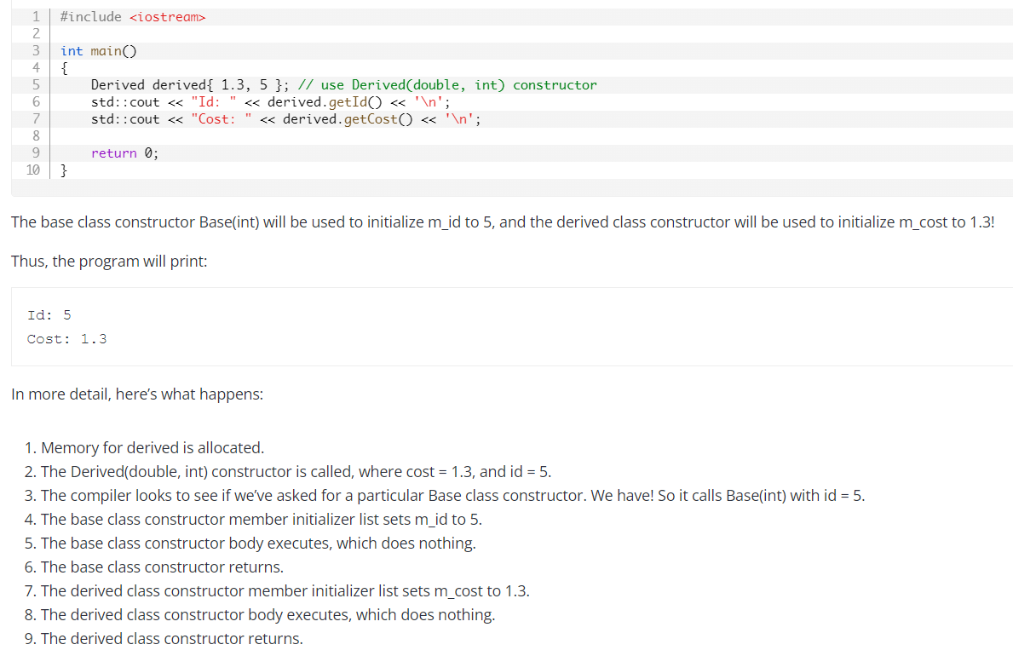
After calling the parent ctor from within the member init list of the child ctor.
Another example with detailed steps. There is yet another example that uses different classes.

Slide 44
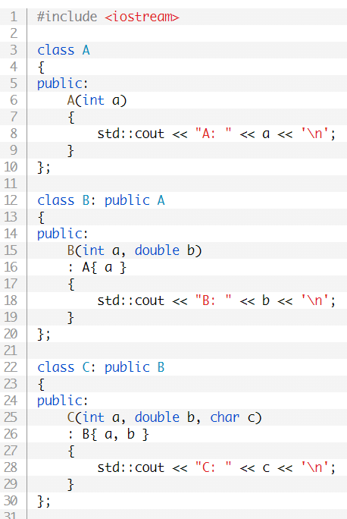
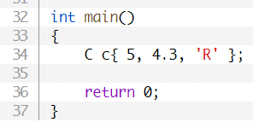

Note that this example just shows the idea that inheritance chains.
5
C c;
A
B
C
5, 4.3
5, 4.3, ‘R’
Output
Notes:
First the A part gets constructed, then the B part, then the C part.

Slide 45

Note that this example just shows the idea that inheritance chains.
5
int main()
{
B b{ 5, 4.3 };
return 0;
}
B b;
A
B
5, 4.3
Output

Slide 46
Reminder for self-study
Don’t forget to go back to slide 23 of this presentation to understand why the output was Unnamed.
There are some questions in the Quiz Time section in the following link for your practice:
https://www.learncpp.com/cpp-tutorial/constructors-and-initialization-of-derived-classes/

Slide 47
Inheritance and Access Specifiers
We will talk about the third access specifier – protected.
https://www.learncpp.com/cpp-tutorial/inheritance-and-access-specifiers/

Slide 48
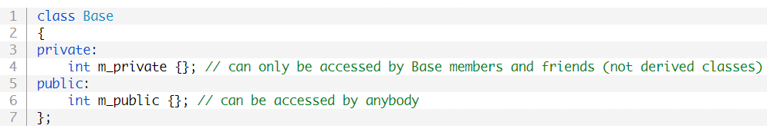
The Good Old…
Question
Can derived classes access the private members of the base class?
private:
Members are only accessible within the member functions of the same class.
Or by friends.
public:
Members are accessible anywhere.

Slide 49
The Good Old…
protected:
Related to inheritance.
These members can be accessed within:
The member functions of their own class.
Friends.
Derived classes.
However, protected members are not accessible from outside the class.

Slide 50
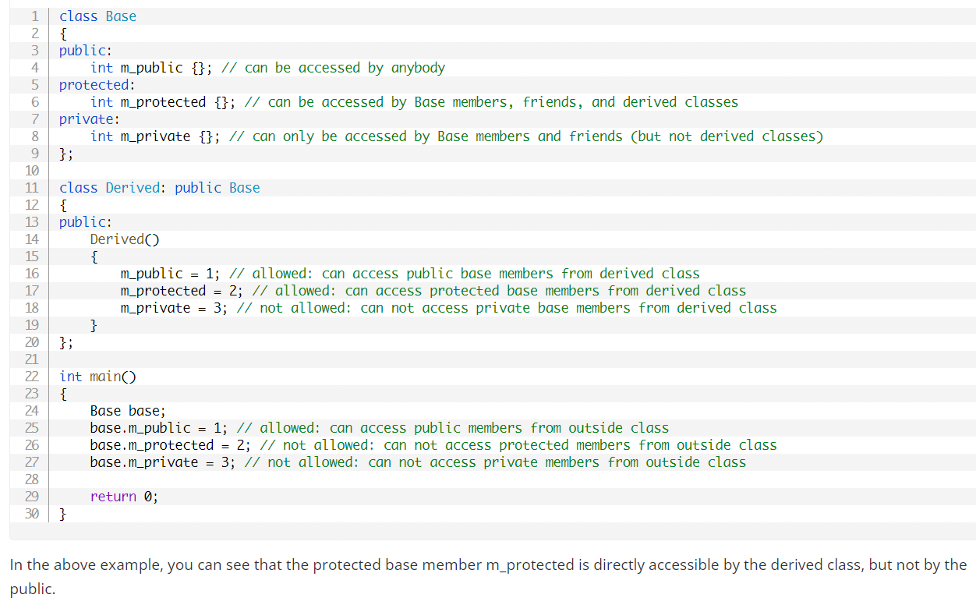

Slide 51
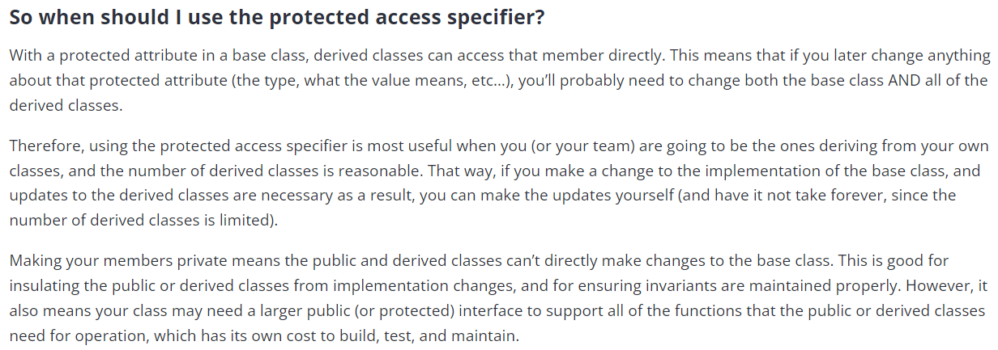


Slide 52

Public Inheritance
There are other types of inheritance – private and protected.
Focus of this course is public inheritance.
When you inherit a base class publicly,
Inherited public members stay public.
Inherited protected members stay protected.
Inherited private members stay inaccessible.

Slide 53
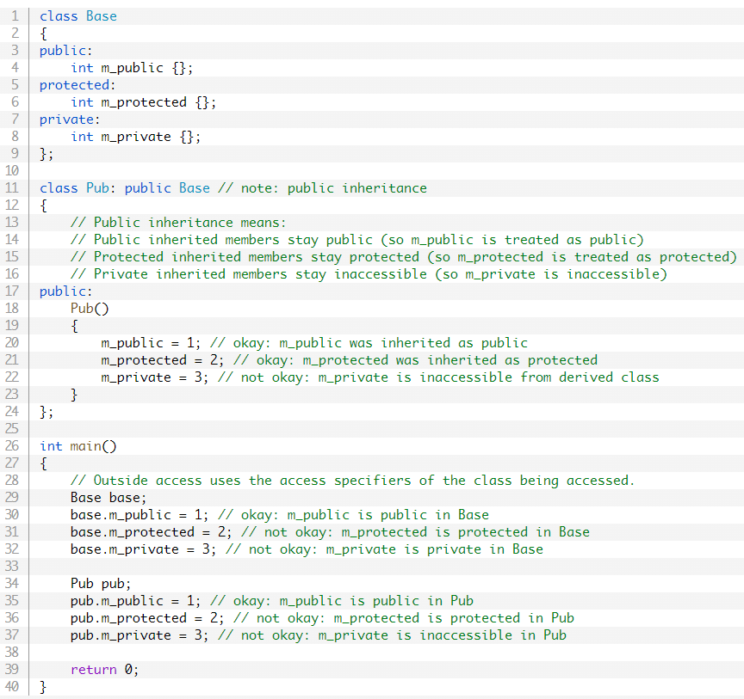
Self study

Slide 54
Modifying the Inherited Functionality within a Derived Class

Slide 55
Modifying the Inherited Functionality within a Derived Class
We can build on top of the inherited members by adding new members.

Slide 56
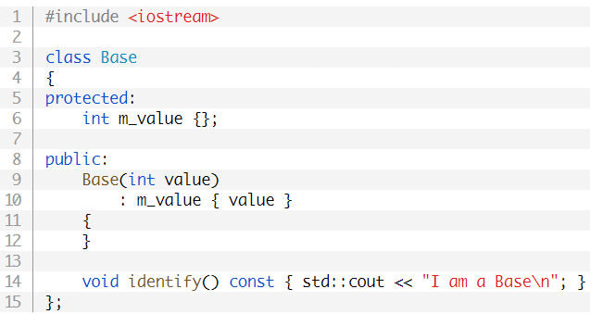
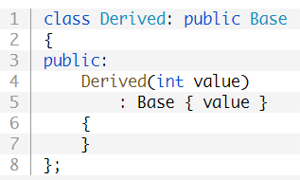
We have set up our classes like so.
Note that within Derived(), I’m initiating a call to the parent class’s constructor with one argument.
Currently, Derived doesn’t really have its own methods and attributes.

Slide 57
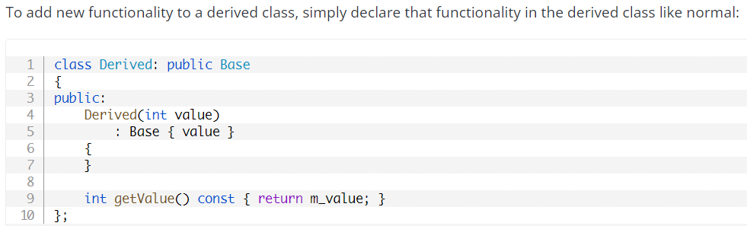
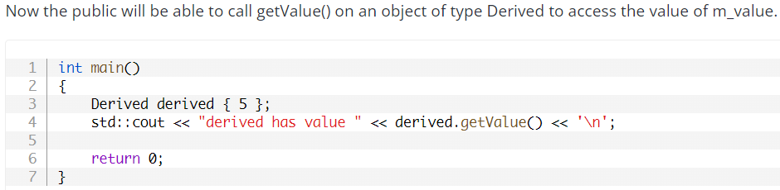
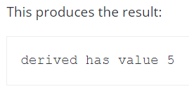
Inheritance allows us to extend or build on top of the parent class.
We have already seen some examples of this.
This is how the object is initialized.
Practically, when you want to add more functionality to third party libraries or built-in classes, you can derive classes from them, and introduce new functionality in the derived classes.
5
5
Notes:
Learncpp.
You could modify the classes directly, but you may or may not have editing rights.
Even if you did, any changes that you made might get overwritten due to some updates.

Slide 58
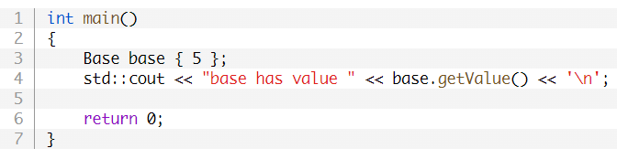
Will the following work?
Nope, class Base doesn’t have the member getValue().
So objects of type Base will not have access to this method.
Because Derived is-a Base, Derived has access to stuff in Base.
However, Base does not have access to anything in Derived.

Slide 59
Modifying the Inherited Functionality within a Derived Class
We can build on top of the inherited members by adding new members.
We can use the inherited members as is.

Slide 60
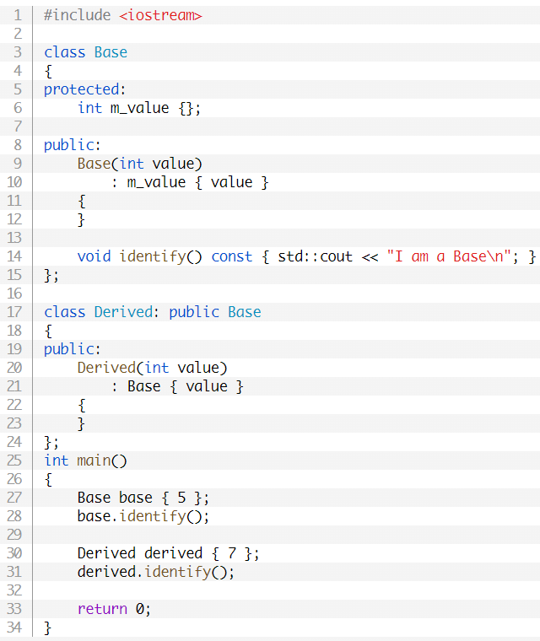
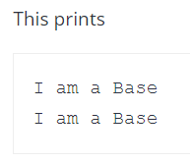



The output of line 28 is easy to figure out. Let’s talk about line 31.
A member function is called with a derived class object (derived in this case).
The compiler first looks to see if that member (identify()) exists in the derived class.
Does Derived::identify() exist or not?
If not, it begins walking up the inheritance chain and checking whether the member has been defined in any of the parent classes.
It uses the first one it finds.
It finds Base::identify() and uses that.
Derived inherited this.
In other words, it uses the most-derived version of the function that it can find.
Found!
Didn’t find

Slide 61
Modifying the Inherited Functionality within a Derived Class
We can build on top of the inherited members by adding new members.
We can use the inherited members as is.
We could even modify the inherited functionality.

Slide 62
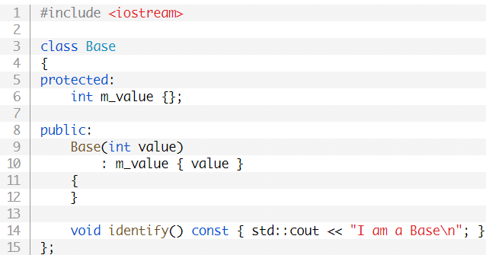
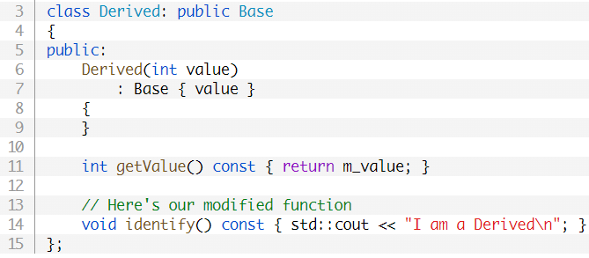
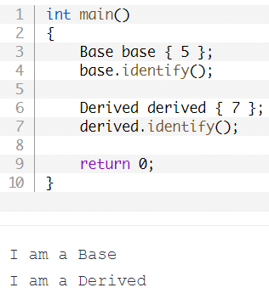
If we had defined Derived::identify() in the Derived class, it would have been used instead.
To modify the way a function works, that has been defined in the base class, simply redefine the function in the derived class.
The compiler will look for identify() in Derived. This time, it’ll find it (unlike in the last example) and will therefore execute it.

Slide 63
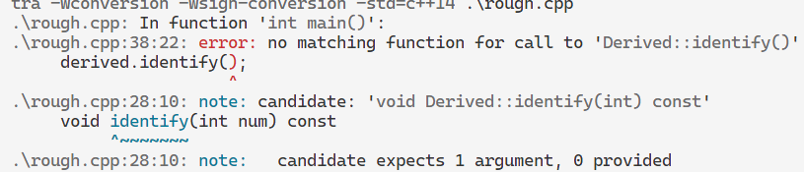
class Base
{
protected:
int m_value {};
public:
Base(int value)
: m_value { value }
{
}
void identify() const { std::cout << "I am a Base\n"; }
};
class Derived: public Base
{
public:
Derived(int value)
: Base { value }
{
}
int getValue() const { return m_value; }
void identify(int num) const
{ std::cout << "I am a Derived and num = " << num << '\n'; }
};
Example
int main()
{
Base base { 5 };
base.identify();
Derived derived { 7 };
derived.identify();
return 0;
}

Slide 64
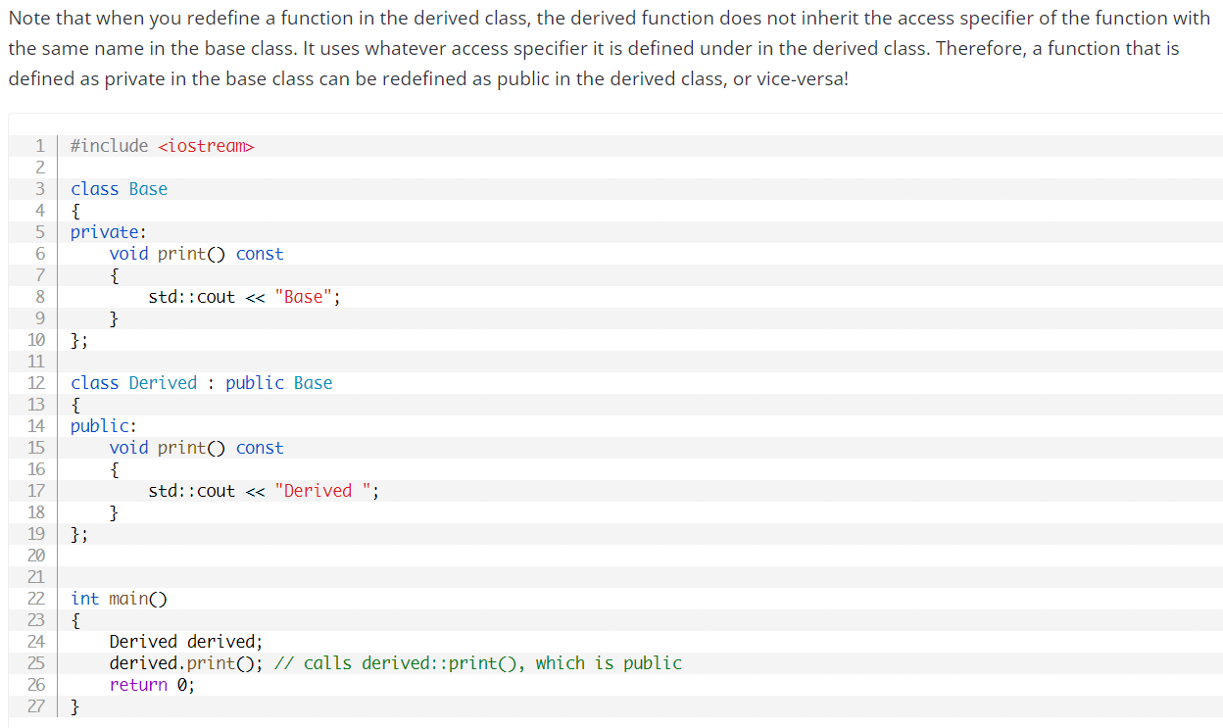
Self study

Slide 65
Modifying the Inherited Functionality within a Derived Class
We can build on top of the inherited members by adding new members.
We can use the inherited members as is.
We could even modify the inherited functionality.
We could build on top of the implementation of an inherited method instead of replacing it with something else.

Slide 66
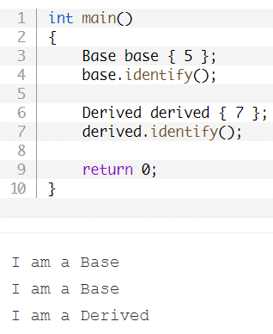
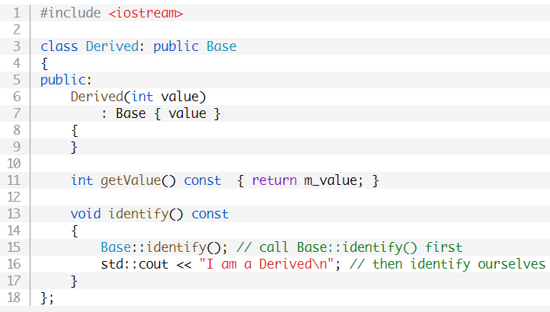
Sometimes we don’t want to completely replace a base class function, but instead want to add additional functionality to it.
What should the hidden implementation look like for me to get the following output?

Slide 67
We can have our derived function call the base version of the function of the same name (in order to reuse code) and then add additional functionality to it.
The following example redefines Derived::identify(). It first calls Base::identify() and then does its own additional stuff.

Slide 68
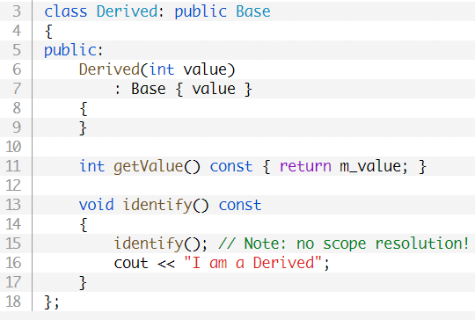
What would happen here?
If you don’t specify the scope resolution operator, then identify() would default to Derived::identify() (the current class).
This would cause Derived::identify() to call itself, which would lead to an infinite recursion!
Note
For testing the infinite recursion, you can add a print statement before the recursive call on line 15 (bottom-right image on slide).

Slide 69
Is there a difference between the two implementations?
No, adding this just means I’m calling the member of the implicit (calling) object. Not writing this means the same thing.
class Derived: public Base
{
public:
Derived(int value)
: Base { value }
{
}
int getValue() const { return m_value; }
void identify() const
{
this->Base::identify();
std::cout << "I am a Derived\n";
}
};

Slide 70
Modifying the Inherited Functionality within a Derived Class
We can build on top of the inherited members by adding new members.
We can use the inherited members as is.
We could even modify the inherited functionality.
We could build on top of the implementation of an inherited method instead of replacing it with something else.
For the interested folks, it is also possible to “hide” the inherited members.

